Slide 1
The OSI Model and the TCP/IP Protocol Suite
Outline:
Protocol Layers
OSI Model
TCP/IP Model
Addressing

Slide 2
OBJECTIVES
To discuss the OSI model and its layer architecture and to show the interface between the layers.
To briefly discuss the functions of each layer in the OSI model.
To introduce the TCP/IP protocol suite and compare its layers with the ones in the OSI model.
To show the functionality of each layer in the TCP/IP protocol with some examples.
To discuss the addressing mechanism used in some layers of the TCP/IP protocol suite for the delivery of a message from the source to the destination.

Slide 3
Computer Network Components
Components of a computer network:
Computer with NIC (PCs, laptops, handhelds)
routers & switches (IP router, Ethernet switch)
Links” Transmission media” (wired, wireless)
protocols (IP,TCP,CSMA/CD,CSMA/CA)
applications (network services) i.e. Network Operating System (NOS)
humans and service agents

Slide 4
PROTOCOL LAYERS
we discussed that a protocol is required when two entities need to communicate.
When communication is not simple, we may divide the complex task of communication into several layers.
The sending computer must:
Recognize the data.
Divide the data into manageable chunks.
Add information to each chunk of data to determine the location of the data and to identify the receiver.
Add timing and error-checking information.
Put the data on the network and send it on its way.
In this case, we may need several protocols, one for each layer.

Slide 5
PROTOCOL LAYERS
Let us use a scenario in communication in which the role of protocol layering may be better understood.
We use two examples. In the first example, communication is so simple that it can occur in only one layer.

Slide 6
Example 1
Assume Maria and Ann are neighbors with a lot of common ideas. However, Maria speaks only Spanish, and Ann speaks only English.
Since both have learned the sign language in their childhood, they enjoy meeting in a cafe a couple of days per week and exchange their ideas using signs.
Occasionally, they also use a bilingual dictionary. Communication is face to face and Happens in one layer as shown in Figure.

Slide 7
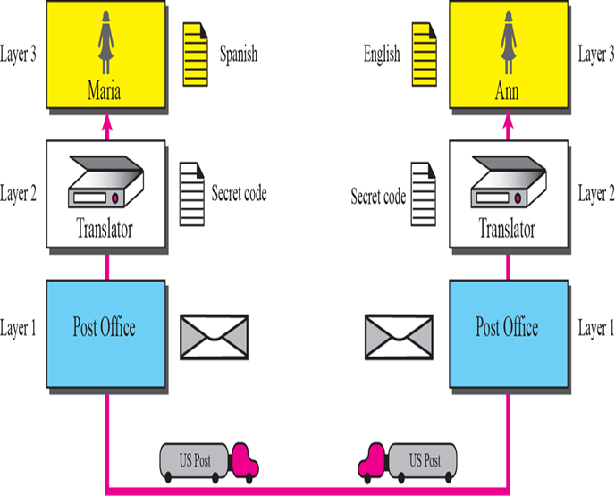
Example 2
Now assume that Ann has to move to another town because of her job. Before she moves, the two meet for the last time in the same cafe.
Although both are sad, Maria surprises Ann when she opens a packet that contains two small machines.
The first machine can scan and transform a letter in English to a secret code or vice versa.
The other machine can scan and translate a letter in Spanish to the same secret code or vice versa.
Ann takes the first machine; Maria keeps the second one.
The two friends can still communicate using the secret code, as shown in Figure.

Slide 8
THE OSI MODEL
Established in 1947, the International Standards Organization (ISO) is a multinational body dedicated to worldwide agreement on international standards.
Almost three-fourths of countries in the world are represented in the ISO.
An ISO standard that covers all aspects of network communications is the Open Systems Interconnection (OSI) model.
It was first introduced in the late 1970s.

Slide 9
Topics Discussed in the Section
Layered Architecture
Layer-to-layer Communication
Encapsulation
Layers in the OSI Model

Slide 10

Note
ISO is the organization;
OSI is the model.

Slide 11
OSI Model and Nora
Application
7th floor
Nora gets secret message from Number One
Presentation
6th floor
Message is translated, encrypted and miniaturized
Session
5th floor
Transport
Security checks message, adds checkpoints to ensure the embassy receives whole message
Network
4th floor
Message is analysed, combined if necessary and broken into smaller pieces
Data Link
3rd floor
Personnel check the message, determine the address, indicate fastest route to Embassy
Physical
2nd floor
Message placed in special packet contains message, sender and destination ID
Prepared for a trip to the KSA Embassy
1st floor

Slide 12

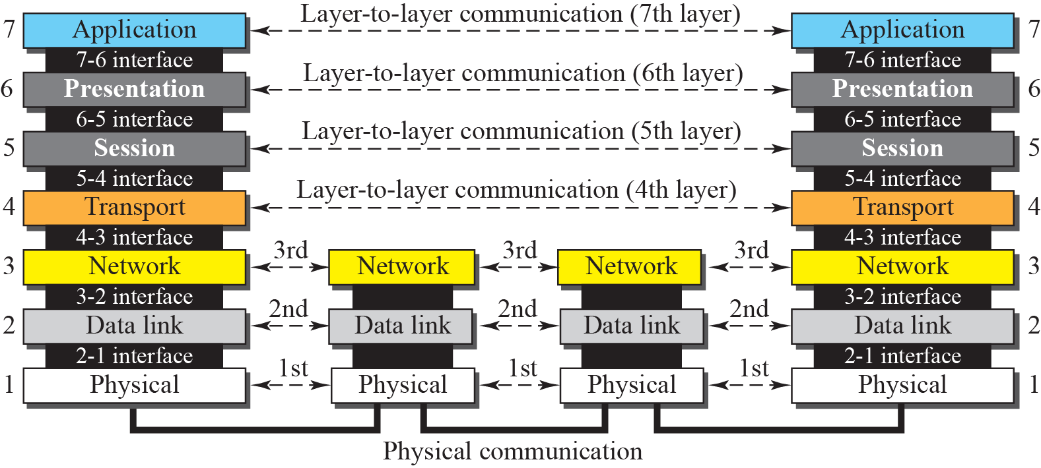
OSI layers

Slide 13
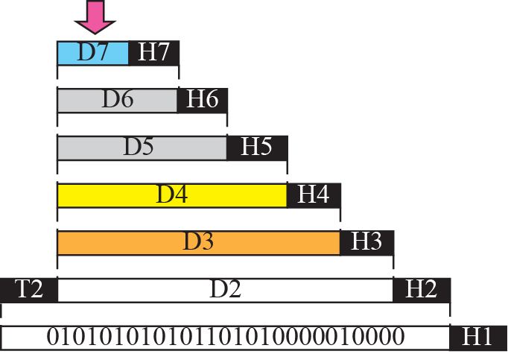


An exchange using the OSI model ( Encapsulation)

Slide 14
Note
The physical layer is responsible for moving individual bits from one
(node) to the next.

Slide 15
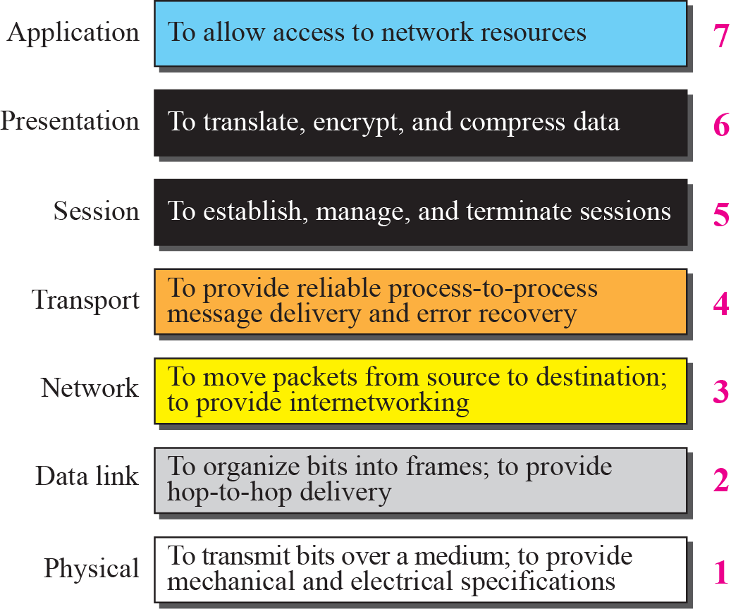
Summary of OSI Layers

Slide 16
TCP/IP Model
The TCP/IP protocol suite was developed prior to the OSI model.
Therefore, the layers in the TCP/IP protocol suite do not match exactly with those in the OSI model.
Application
Troubleshooting, file sharing, internet
Transport
Flow control, error control
Internet
Network Access
IP addressing and routing of network traffic
Interface with the physical network

Slide 17
Comparison between OSI and TCP/IP
IOS Model
TCP/IP Model
Application
Presentation
Session
Transport
Network
Data Link
Physical
Application
Transport
Internet
Network Access

Slide 18
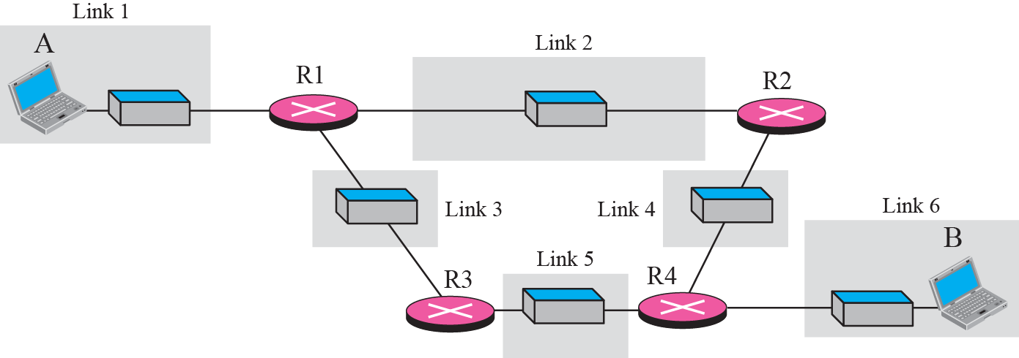
A private internet

Slide 19
LAYERS IN THE OSI MODEL
In this section we briefly describe the functions of each layer in the OSI model.

Slide 20
Physical layer
defines the procedures and functions that physical devices and interfaces have to perform for transmission occur.
The physical layer is concerned with the following:
Physical characteristics of interfaces and media:
Representation of the bits
Data rate, the number of bits sent each second.
Line configuration, Point to point or multipoint configuration.
Physical topology
Transmission Mode : Simplex, half duplex or full duplex

Slide 21
Communication at the physical layer

Slide 22
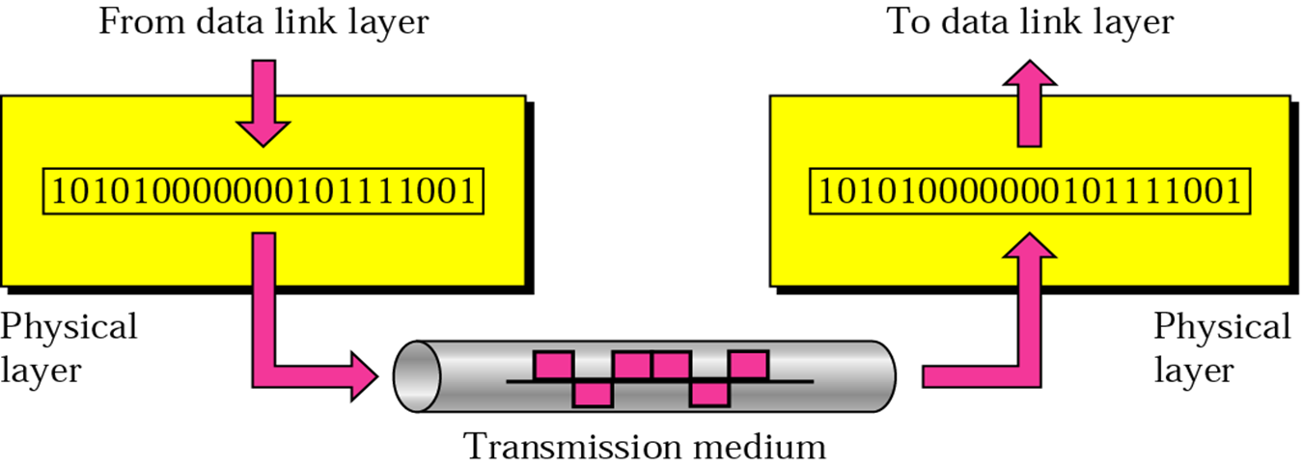
Note
The unit of communication at the physical layer is a bit.

Slide 23
Data Link Layer
The data link layer transforms the physical layer, a raw transmission facility, to a reliable link and is responsible for node-to-node delivery.
The Data Link layer is concerned with the following:
Framing.
Physical addressing, each node has its unique address.
Flow Control.
Access Control.
Error control, normally achieved through a trailer to the end of the frame.

Slide 24
Communication at the data link layer

Slide 25
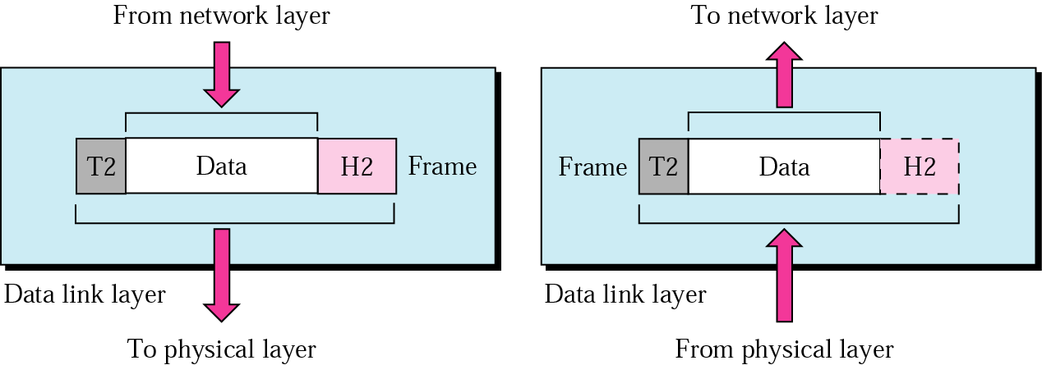
Note
The unit of communication at the data link layer is a frame.

Slide 26
Network Layer
Is responsible for the source-to-destination delivery of a packet possible across multiple networks.
Functions:
Logical addressing.
Routing, It determines which path the data should take based on network conditions, priority of service, and other factors.

Slide 27
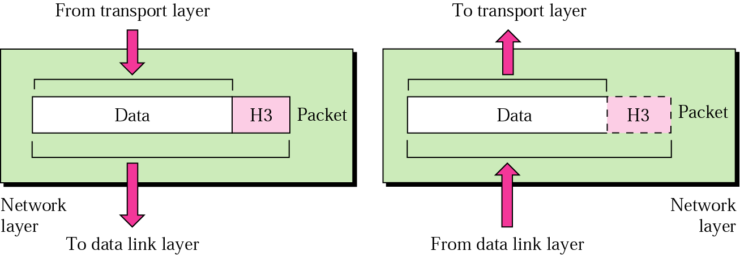
Note
The unit of communication at the network layer is a datagram (Packet).

Slide 28
Transport Layer
The transport layer is responsible for process-to-process delivery of the entire message.
Makes sure that the data arrives without errors, in the proper sequence and in a reliable condition.
Functions:
Port addressing, The network layer gets each packet to the correct computer; the transport layer gets the entire message to the correct process on that computer.
Segmentation and reassembly: a message is divided into transmittable segments, each having a sequence number
Connection control: The transport layer can be either connectionless or connection-oriented.
Flow control
Error control
Notes:
A connectionless transport layer treats each segment as an independent packet and delivers it to the transport layer at the destination machine.
A connection-oriented transport layer makes a connection with the transport layer at the destination machine first before delivering the packets. After all the data are transferred, the connection is terminated.

Slide 29
Communication at transport layer

Slide 30
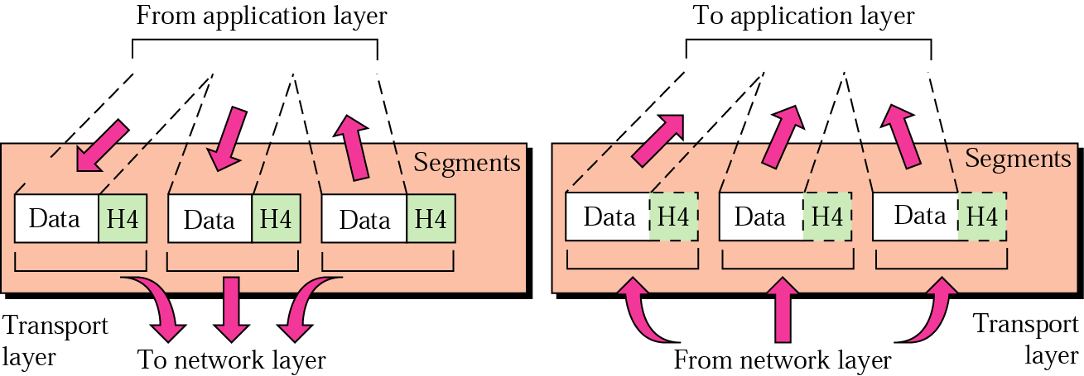
Note
The unit of communication at the transport layer is a segment, user datagram, or a packet, depending on the specific protocol used in this layer.

Slide 31
Session Layer
the session layer, allows two applications on different computers to open, use, and close a connection called a session.
(A session is a highly structured dialog between two workstations.)
Functions:
Dialog control
It also makes sure the session is orderly, establishing which node transmits first, how long it can transmit, and what to do in case of an error.
It performs name-recognition and other functions, such as security, that are needed to allow two applications to communicate over the network.
Synchronization
The session layer synchronizes user tasks by placing checkpoints in the data stream.
The checkpoints break the data into smaller groups for error detection. It allows information of different streams, perhaps originating from different sources, to be properly combined or synchronized.
An example application is web conferencing, in which the streams of audio and video must be synchronous to avoid so-called lip synch problems. It ensures that the person displayed on screen is the current speaker.

Slide 32
presentation layer
The presentation layer is responsible for translation, compression, and encryption.
Deals with the actual formatting of the data.
For example, data might be converted from EBCDIC to ASCII formatting so that the receiving node can understand it.

Slide 33
Application Layer
This layer relates to the services that directly provide user interfaces support user applications or services, such as software for file transfers, database access, and e-mail.
In other words, it serves as a window through which application processes can access network services.
The application layer enables the user to access the network.
This would be the layer that a programmer uses to allow his application to access a network service, such as linking into a database.

Slide 34
Communication at application layer

Slide 35
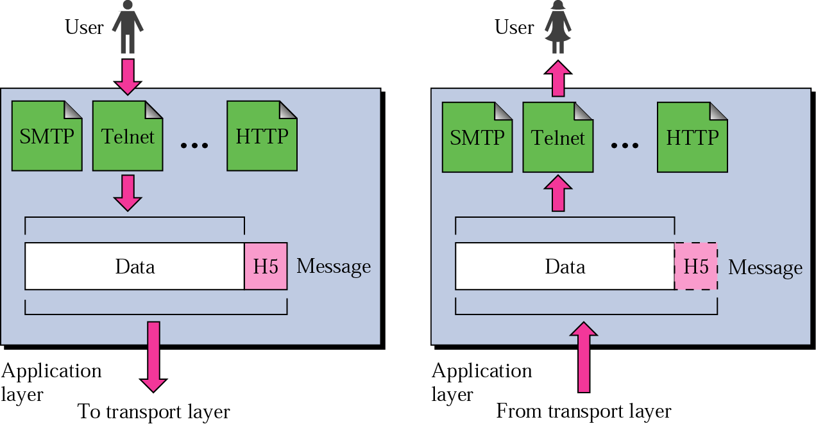
Note
The unit of communication at the application layer is a message.

Slide 36
ADDRESSING
Four levels of addresses are used in an internet employing the TCP/IP protocols:
physical address
logical address
port address
application-specific address.

Slide 37
Each address is related to a one layer in the TCP/IP architecture, as shown in Figure.
IOS Model
TCP/IP Model
Application
Presentation
Session
Transport
Network
Data Link
Physical
Application Spec. Address
Application
Transport
Internet
Network Access
Port Address
Logic Address
Physical Address

Slide 38
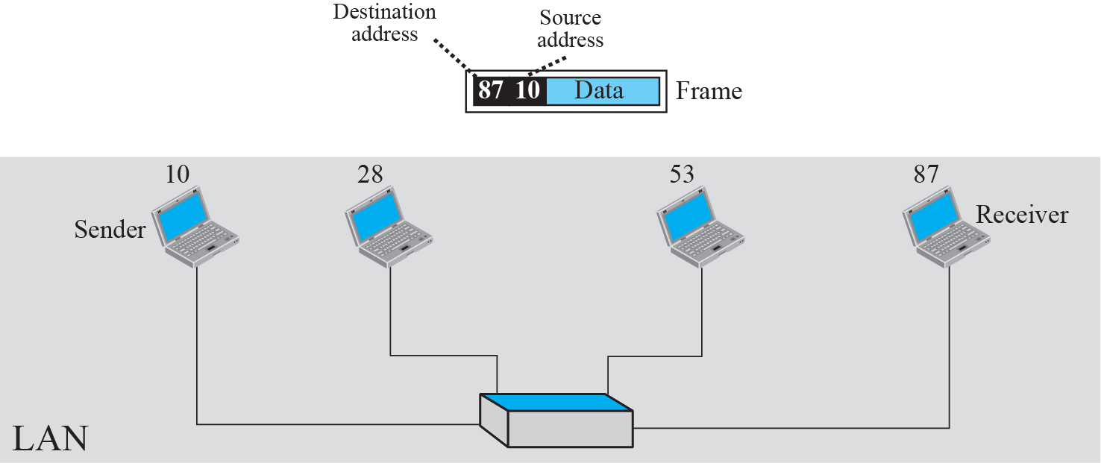
Example 1: physical addresses

Slide 39
Example 1
As we will see later, most local area networks represent the physical address in two ways:
IPv4
use a 32-bit (4-byte) physical address written as decimal digits; every byte (2 hexadecimal digits) is separated by a dot, as shown below
IPv6 ( new version)
use a 48-bit (6-byte) physical address written as 12 hexadecimal digits; every byte (2 hexadecimal digits) is separated by a colon, as shown below:
128.7.0.0
A 4-byte (a byte represent 8 bits called octet ) physical address
07:01:02:01:2C:4B
A 6-byte (12 hexadecimal digits) physical address

Slide 40
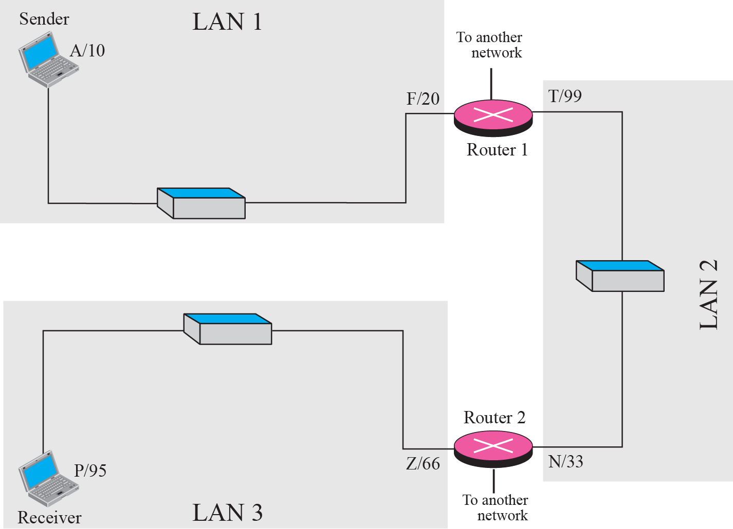
Example 2: logical addresses
Notes:
Figure 2.17 shows a part of an internet with two routers connecting three LANs. Each device (computer or router) has a pair of addresses (logical and physical) for each connection. In this case, each computer is connected to only one link and therefore has only one pair of addresses. Each router, however, is connected to three networks. So each router has three pairs of addresses, one for each connection. Although it may be obvious that each router must have a separate physical address for each connection, it may not be obvious why it needs a logical address for each connection. We discuss these issues in Chapters 11 and 12 when we discuss routing. The computer with logical address A and physical address 10 needs to send a packet to the computer with logical address P and physical address 95. We use letters to show the logical addresses and numbers for physical addresses, but note that both are actually numbers, as we will see in later chapters.

Slide 41
Note
The physical addresses will change from hop to hop, but the logical addresses remain the same.

Slide 42
Example 2
the purpose of ports is to uniquely identify different applications or processes running on a single computer and thereby enable them to share a single physical connection to a packet-switched network like the Internet.

Slide 43
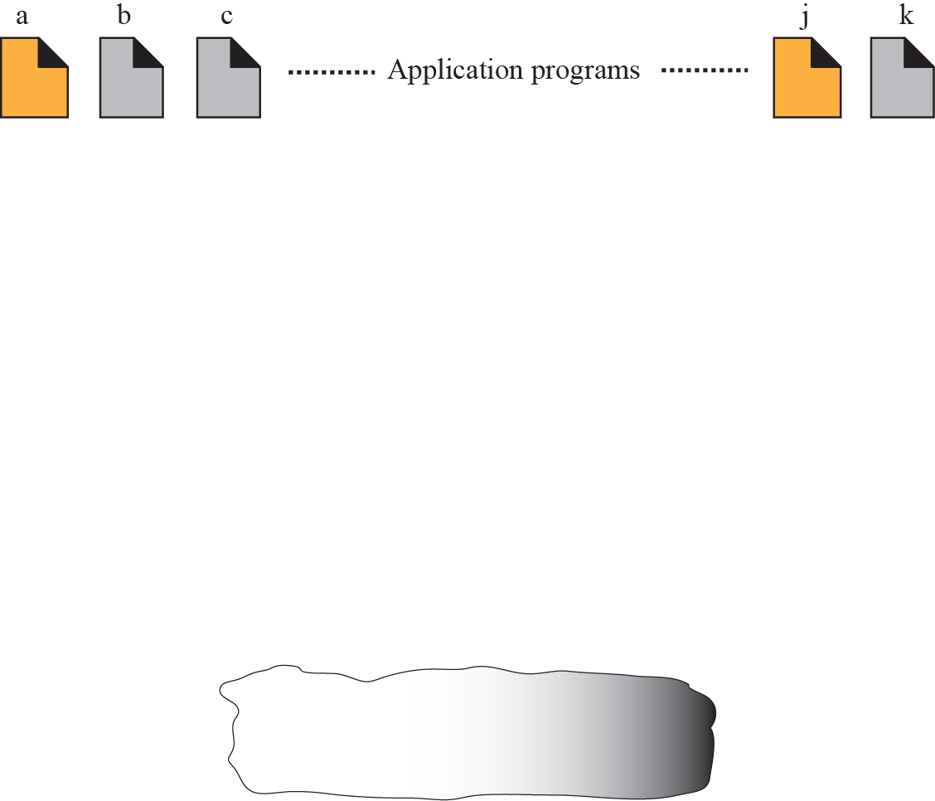
Example 3: port numbers
Notes:
Figure 2.18 shows two computers communicating via the Internet. The sending computer is running three processes at this time with port addresses a, b, and c. The receiving computer is running two processes at this time with port addresses j and k. Process a in the sending computer needs to communicate with process j in the receiving computer. Note that although both computers are using the same application, FTP, for example, the port addresses are different because one is a client program and the other is a server program, as we will see in Chapter 17.

Slide 44
Note
The physical addresses change from hop to hop, but the logical and port addresses usually remain the same.

Slide 45
Example 3
a port address is a 16-bit address represented by one decimal number as shown.
753
A 16-bit port address represented as one single number

Slide 46
References
http://pluto.ksi.edu/~cyh/cis370/ebook/ch05b.htm
CSC 1202 2012-2013 Lecture Notes.
Chapter 2 in TCP/IP Protocol Suite , 4th ed, Behrouz A. Forouzan

